Slide 1
Multimodal Learning for Identifying Opportunities for Empathetic Responses
Multimodal Dialogue systems 2021
Saarland university
Lakshmi Rajendram Bashyam (2581455)

Slide 2
This paper presents
Outline
>Introduction
Dataset
Feature extr.
Analysis
Architecture
Experiment
Results
Conclusion
Provides a deep learning framework for recognizing the degree and instances when the intelligent virtual agent should respond with an empathetic response to the user.
Analysis of interpretable multimodal features
Evaluation of model in semi-structured dyadic interaction with real-world users

Slide 3
Empathy
Outline
>Introduction
Dataset
Feature extr.
Analysis
Architecture
Experiment
Results
Conclusion
Empathy captures one’s ability to correlate with and understand others’ emotional states and experiences
Important for intelligent agent to show empathy for smoother interactions and increased bonding.
Example: “I was addicted to drugs, but I have recovered”
Sentiment: Negative
Empathy: Positive. Congrats on recovery
Notes:
Especially in the healthcare domains dealing with mental illness and also in education
empathetic emotions lead to greater likeability and trustworthiness of the agent

Slide 4
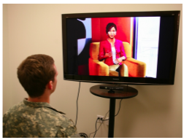
Dataset details
Outline
Introduction
> Dataset
Feature extr.
Analysis
Architecture
Experiment
Results
Conclusion
Distress Analysis Interview Corpus (DAIC)
Multimodal collection of semi-structured clinical interviews.
For identifying people at risk for post-traumatic stress disorder (PTSD) and major depression
Subset: Wizard-of-Oz interviews: conducted by an animated virtual interviewer called Ellie, controlled by a human interviewer in another room
Modality
audio, video, and depth sensor
Distress Analysis Interview Corpus (DAIC)
Multimodal collection of semi-structured clinical interviews.
For identifying people at risk for post-traumatic stress disorder (PTSD) and major depression
Subset: Wizard-of-Oz interviews: conducted by an animated virtual interviewer called Ellie, controlled by a human interviewer in another room
Modality
audio, video, and depth sensor
Notes:
Motive
Ellie’s behaviour in the Wizard-of-Oz collection was controlled by two wizards, responsible for non-verbal behaviours (e.g., nods and facial expressions) and verbal utterances
Ellie had a fixed set of utterances:
pre-recorded audio of the wizard that controlled Ellie’s verbal behaviour controlled by one wizard
pre-animated gestures and facial expressions based on those typically employed during the face-to-face interviews controlled by other

Slide 5
Dataset sample
Outline
Introduction
> Dataset
Feature extr.
Analysis
Architecture
Experiment
Results
Conclusion
Negative | A: How have you been feeling lately? H: Um kind of uh I guess sorta sorta depressed generally A: Tell me more about that H: Uh just uh feeling tired and sluggish and um less less motivated and less interested in things A: I’m sorry to hear that.
Positive | A: What are you most proud of in your life? H: Uh I’m proud that I’ve come a long way from when I first moved out here. I’m uh a lot more disciplined um I read a lot uh I do crosswords and I think I’ve I think I know what’s important in life now and I’m more focused and going after what I want A: That’s so good to hear
None | A: What are somethings you wish you could change about yourself? H: Um I wish I could be taller I wish I could be more inclined to play basketball, so I then become go to the NBA and be a millionaire I know that’s all unrealistic but just answering honestly.

Slide 6
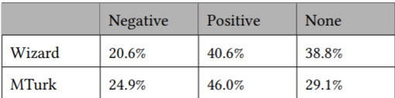
Ground truth label
Outline
Introduction
> Dataset
Feature extr.
Analysis
Architecture
Experiment
Results
Conclusion
Three classes – Negative empathy, positive empathy and None based on wizard’s response
Validation of Wizard’s response: Each instance rated by 5 persons on Amazon mechanical Turk
Differences are from annotating None as pos/neg due to lack of context of conversation
Only 58% agreement among MTurk
Notes:
Negative empathetic responses include utterances such as "That sounds really hard" and "I’m sorry to hear that",
positive empathy includes utterances like "That’s so good to hear", "That sounds like a great situation",
no empathetic responses shows that the agent moved on

Slide 7
Multimodal feature extraction
Outline
Introduction
Dataset
>Feature extr.
Analysis
Architecture
Experiment
Results
Conclusion
Text features
Audio Features
Video features

Slide 8
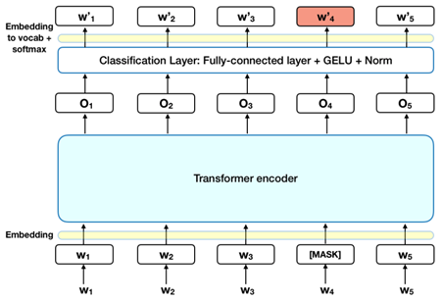
Text features
Outline
Introduction
Dataset
> Feature extr.
> Text
Audio
Video
Analysis
Architecture
Experiment
Results
Conclusion
BERT (Bidirectional Encoder Representations from Transformers)
Transformers
Notes:
For detailed information, BERT paper or there are many blogs available online.
Unlike other transformer models that came out before bert, it employed bidirectional encoding. i.e., look ahead and look behind.
In traditional transformer it is only look behind

Slide 9

Text features
Outline
Introduction
Dataset
> Feature extr.
> Text
Audio
Video
Analysis
Architecture
Experiment
Results
Conclusion
BERT (Bidirectional Encoder Representations from Transformers)
Masked LM
Next sentence prediction (NSP)
Uncased BERT-Base
768-dimension vector representation

Slide 10
Audio features
Outline
Introduction
Dataset
> Feature extr.
Text
> Audio
Video
Analysis
Architecture
Experiment
Results
Conclusion
39 Feature set
Extracted from openSmile
Extended Geneva Minimalistic Acoustic Parameter Set (eGeMAPS) - 24
Set of Low-level Descriptor features that haven been suggested as the most related to emotions.
MFCC (mel-frequency cepstral coefficient) - 15
MFCC features represent phonemes as the shape of the vocal tract from which manifest them
13 MFCC + first and second derivative
Notes:
Phonemes - (distinct units of sound)
Vocal tract - (which is responsible for sound generation)
MFCC representation is an example of a method that further analyzes the Fast Fourier Transform of the speech signal. The value of the method is attributed to its similarity to the functioning of the human auditory system.

Slide 11
Visual features
Outline
Introduction
Dataset
> Feature extr.
Text
Audio
> Video
Analysis
Architecture
Experiment
Results
Conclusion
17 Action units
6 head pose
ResNet model
Extracted using openFace library
Notes:
Movements of individual facial muscles are encoded by FACS from slight changes in facial appearance

Slide 12
Action units
Outline
Introduction
Dataset
> Feature extr.
Text
Audio
> Video
Analysis
Architecture
Experiment
Results
Conclusion
17 Action units
Based on FACS (Facial Action coding system): taxonomize human facial movements by their appearance on the face
Using FACS it is possible to code facial expression into the specific Action Units (AU) that produced the expression
Intensity scoring
AU 2E A Trace
B Slight
C Marked or pronounced
D Severe or extreme
E Maximum
Notes:
Movements of individual facial muscles are encoded by FACS from slight different instant changes in facial appearance

Slide 13
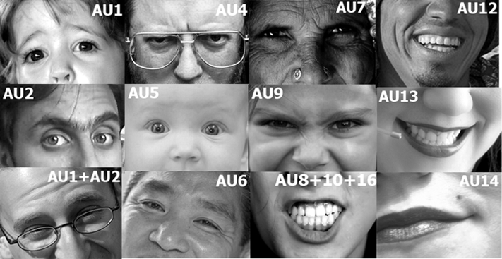

Action units
Outline
Introduction
Dataset
> Feature extr.
Text
Audio
> Video
Analysis
Architecture
Experiment
Results
Conclusion
AC14
Notes:
1 – Inner brow raiser
2 – Outer brow raiser
4 – brow lower
5 – upper lid raiser
6 – cheek raiser
7 – lid tighten
9 – nose wrinkle
12 – lip corner pull
13 – cheek puffer

Slide 14
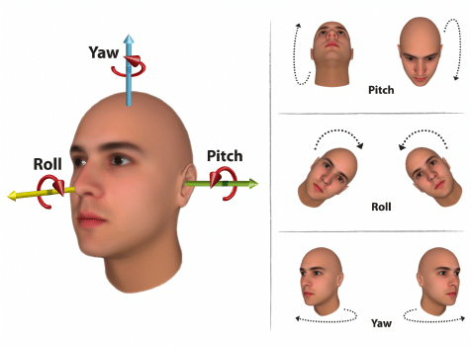
Head pose
Outline
Introduction
Dataset
> Feature extr.
Text
Audio
> Video
Analysis
Architecture
Experiment
Results
Conclusion
Head pose is represented by 6 features:
pose_Tx, pose_Ty, pose_Tz the location of the head with respect to camera in millimeters (positive Z is away from the camera)
pose_Rx, pose_Ry, pose_Rz Rotation is in radians around X,Y,Z axes
pitch (Rx), yaw (Ry), and roll (Rz)

Slide 15
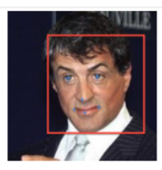
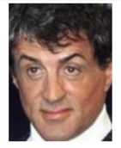


Resnet
Outline
Introduction
Dataset
> Feature extr.
Text
Audio
> Video
Analysis
Architecture
Experiment
Results
Conclusion
Input feature :
Masked and Aligned faces per frame
Pretrained Resnet-50 model on ImageNet dataset
2048-d output feature
Aligned
Masked

Slide 16
Behavior Analysis
Outline
Introduction
Dataset
Feature extr.
> Analysis
Architecture
Experiment
Results
Conclusion
Interpretable features
Vison – Facial Action Units (FAUs)
Audio – eGeMAPS
Text – LIWC (Linguistic enquiry and word count)
dictionary-based, automatic quantitative text analysis
Example: Positive emotion – love, nice, sweet
Negative emotion – hurt, ugly, nasty
Social – Talk, us, friend

Slide 17
Result
Outline
Introduction
Dataset
Feature extr.
> Analysis
Architecture
Experiment
Results
Conclusion
Text – Sentiment, Tone, positive and negative emotion, Formal, Social, Cognitive process
Visual – AU06 (cheek raiser), AU12 (lip puller), AU14 (lip corner depressor)
Audio – no significant feature
Notes:
Cognitive – involves causation, certainty – positive
Social – negative
Formal – negative

Slide 18
Model architecture
Outline
Introduction
Dataset
Feature extr.
Analysis
>Architecture
Experiment
Results
Conclusion
Unimodal
Static fusion
RNN fusion

Slide 19
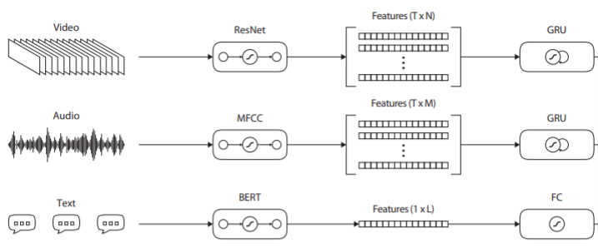
Unimodal
Outline
Introduction
Dataset
Feature extr.
Analysis
> Architecture
> Unimodal
Static fusion
RNN fusion
Experiment
Results
Conclusion
Maps every modality to fixed size vector followed by SoftMax layer for classification
Notes:
Language information is encoded with instance-based encoders. These encoders consist of a single fully connected (FC) layer of a fixed size.
Sequences of audio and visual features were fed to a single layer gated recurrent unit (GRU) that maps the vision and speech representations to a fixed size embedding, keeping only the last state.

Slide 20
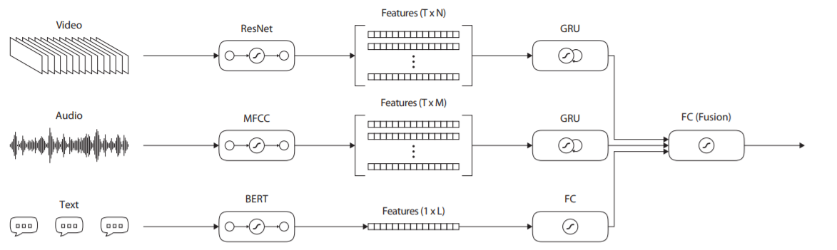
Static fusion
Outline
Introduction
Dataset
Feature extr.
Analysis
> Architecture
Unimodal
>Static fusion
RNN fusion
Experiment
Results
Conclusion
The embeddings from each unimodal models are concatenated and given as input to a fully connected layer followed by SoftMax for classification
It does not capture the temporal nature of the vision and audio modalities

Slide 21
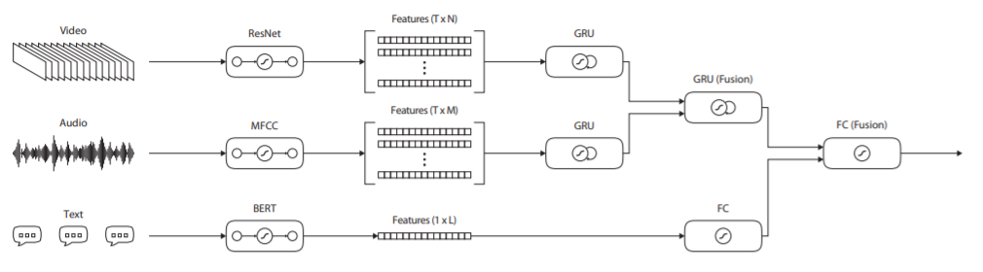
RNN fusion
Outline
Introduction
Dataset
Feature extr.
Analysis
> Architecture
Unimodal
Static fusion
> RNN fusion
Experiment
Results
Conclusion
The temporal embeddings (embeddings extracted per frame capturing time characteristics) of audio and video are concatenated and fed into RNN fusion layer.
The last state of RNN fusion is a 128-d fixed size vector
Weighted cross entropy loss for data imbalance

Slide 22
Experiment
Outline
Introduction
Dataset
Feature extr.
Analysis
Architecture
> Experiment
Results
Conclusion
Dropout of 0.2 in fully connected layer
Fully connected layer for Resnet after GRU and BERT to reduce dimensionality to 128-d
Baseline model
VADER (Valence aware dictionary and sentiment reasoner) – lexicon and rule-based sentiment analysis tool

Slide 23
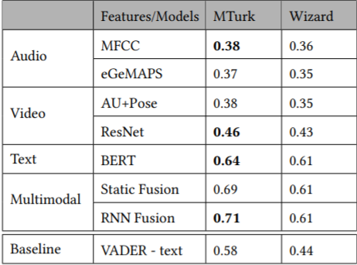
Results
Outline
Introduction
Dataset
Feature extr.
Analysis
Architecture
Experiment
> Results
Conclusion
Text unimodal performs better than video and audio.
Why? Low expressiveness in audio and video, low quality audio
Model trained on MTurk produces better results than Wizard.
Why? Model cannot capture the context
of conversation used by wizard.
RNN fusion performs better than Static
Why? RNN fusion captures the temporal
dynamics

Slide 24
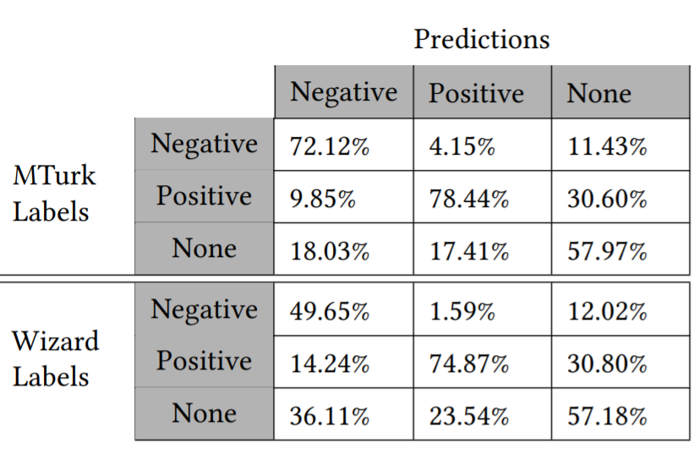





Results
Outline
Introduction
Dataset
Feature extr.
Analysis
Architecture
Experiment
> Results
Conclusion
Majority of misclassification : pos/neg labels to none and none to pos/neg labels
Sensitive errors: pos to neg and neg to pos

Slide 25
Summary
Outline
Introduction
Dataset
Feature extr.
Analysis
Architecture
Experiment
Results
> Conclusion
Dataset annotation to identify the opportunity and degree of empathetic response.
Behavior analysis showed the significance of text and visual features.
BERT outperforming other unimodal models and multimodal RNN fusion achieving highest F1 score of 0.71.
Analyzing the results and identifying areas of improvement.

Slide 26
Thank you

